Slide 1
INFORMATION GATHERING
DATA GATHERING TOOL : MICROSOFT FORMS
RESPONSES: 108 UNDERGRADUATES FROM SLIIT
(ANONYMOUS) RESPONSES
INTERVIEW
INTRODUCTION
This study explores SLIIT students’ perceptions of canteens and their dining habits, emphasizing the Impact on health, mood, anddaily routines. The canteens serve as more than just eateries; they’re social hubs for students to gather, eat, and enjoy time with friends.
FOOD QUALITY,
TASTE,
HYGIENE AND CLEANLINESS,
MENU VARIETY,
WAITING TIME,
HOSPITLTY OF STAFF,
PRICE RANGE AND VALUE.
METHODS
This survey explores university students’
canteen attitude and preferences using varied methods,
Including;
• ONLINE SURVEYS
•OBSERVATIONAL ANALYSIS
• FOCUS GROUP DISCUSSIONS
SLIIT students' attitudes and preferences regarding services provided by canteens at SLIIT
MLB_04.02_03
INTRODUCTION
D
Content
METHODS
INFORMATION GETHERING
C
B
DATA ANALYSIS
POSITIVE IMPACTS, NEGATIVE IMPACTS
A
SUGGETIONS & CONCLUTION
CONCLUTION

Slide 2

Group Members
1. IT23227804 RANDUNUGE N.V
2. IT23227354 W.C.S.A.LOWE
3. IT23223912 LAMAHEWA L.H.R.C
4.IT23218758 SURAWEERA T.R.S
5. IT23228658 HASARANGA I.W.K

Slide 3
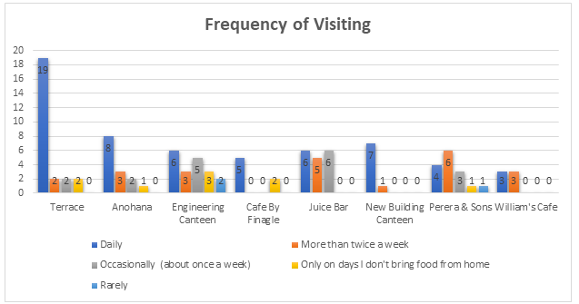
Graphs 1
Various factors influence student canteen visits, including personal schedule, dietary preferences, and budget.
Some students visit canteens at least once a week, while others only on specific days when they can't bring food from home.
The graph illustrates visit frequencies across eight different canteens on campus, with bars representing daily, occasional, weekly, rare, and specific day visits.
Understanding student canteen visit patterns is essential for canteen management to tailor services effectively to student needs.

Slide 4
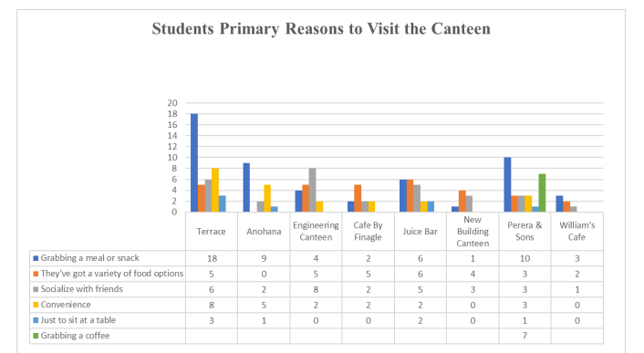
Graph 2
Terrace Canteen is the most frequently chosen option for students to grab a meal, with 18 respondents selecting it.
Anohana Canteen and Perera & Sons rank second and third respectively in terms of meal selection frequency.
New Building Canteen and William’s Café are the least popular choices for meals, with only one and three respondents selecting them.
Possible reasons for these choices include perceptions of healthier options or cost considerations.
While the graph doesn't explicitly express preferences, it provides insights into which canteens students perceive as offering the best dining options for various needs such as studying, socializing, meals, and snacks.

Slide 5
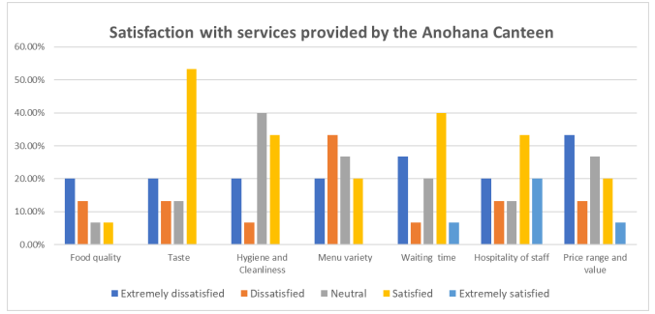
Students’ satisfaction with services provided by each canteen at SLIIT
Graphs 3
Anohana Canteen received high satisfaction ratings for food quality and taste, with 60% and 55% of respondents respectively.
Cleanliness and hygiene were also positively rated, with 45% of respondents expressing satisfaction.
Menu variety received a slightly lower satisfaction score of 40%.
Other factors like staff friendliness, waiting time, and price range received the lowest satisfaction ratings, with only 35% of respondents giving the highest ratings.

Slide 6
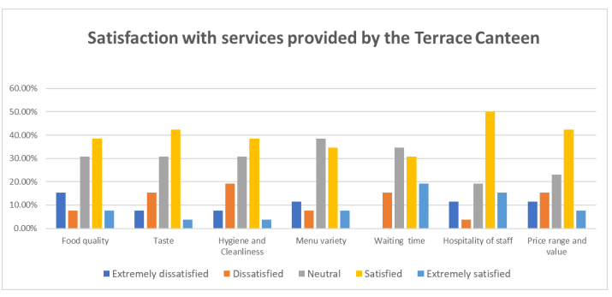
Graph 4
The bar chart depicts satisfaction levels across six service categories at the Terrace Canteen.
Students express high satisfaction regarding food quality, taste, cleanliness, and hygiene.
However, improvements are suggested for staff friendliness and waiting times.
Overall, the Terrace Canteen receives positive feedback from students.
The graph highlights areas of strength and areas for potential enhancement in Terrace Canteen services.

Slide 7
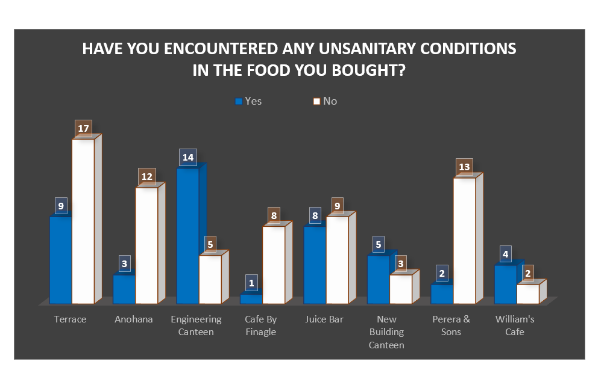
Is SLIIT canteen food really healthy enough for
Students?
Graph 5
Survey participants responded regarding encountering unsanitary conditions in campus canteens.
Engineering Faculty Canteen had the highest number of respondents reporting unhealthy situations.
Specific incidences of unsanitary conditions were not detailed in the survey.
Comparative analysis suggests a higher percentage of unsanitary conditions at the Terrace Canteen than at the Anohana Canteen.
The graph underscores that respondents experienced health concerns at various canteens on campus.

Slide 8
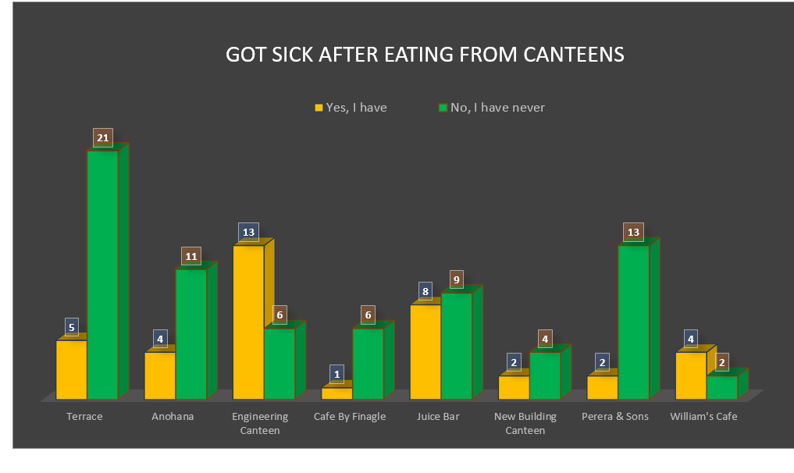
Graph 6
Some students reported getting sick after eating at certain SLIIT canteens, notably the Engineering Faculty Canteen.
The graph indicates a higher incidence of sickness from food consumed at the Engineering Faculty Canteen compared to other canteens.
While the Juice Bar and Terrace Canteen also caused sickness for some students, the majority did not fall ill after eating at the Terrace Canteen.
Eevery canteen had students who reported getting sick, emphasizing the importance of prioritizing hygiene and food quality.

Slide 9
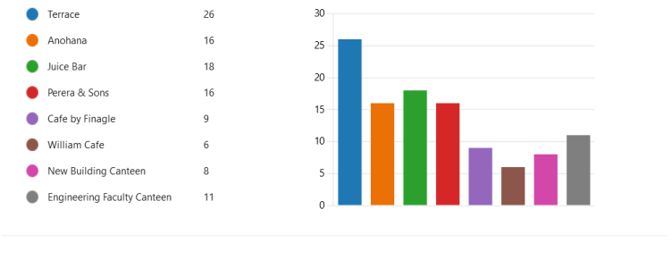
Graph 7
Terrace canteen received the highest number of visits among SLIIT canteens, with 26 responses.
Juice Bar and Anohana canteens followed closely, with approximately 16 and 18 visits respectively.
Perera & Sons had around 14 responses, while the Engineering Faculty Canteen and William Cafe received about eleven and nine visits respectively.
Cafe by Finagle had the fewest visits, averaging about 6 responses.
The New Building Canteen attracted the least number of students.

Slide 10


What are the food item/s would students recommend from this canteens?
Ice coffee and chicken rolls
Chicken puff pastry
Pastry
Chicken puff pastry Donut
Cheese Sandwich
Domino cakes

Slide 11
Student responses

Slide 12
Conclusion
Student feedback can inform authorities about areas needing improvement in university canteens.
Implementing an assessment guide can help raise the standard of canteen services at SLIIT.
Continuous monitoring of food quality is crucial for preventing diet-related diseases.
Besides food quality, other factors like environment and hygiene should also be considered in assessing service quality.
Given that university canteen diners are mostly young adults, maintaining high standards of food and hygiene is vital for their health and development

Slide 13


Any questions

Slide 14
References

Slide 15

Thank you

